Slide 1
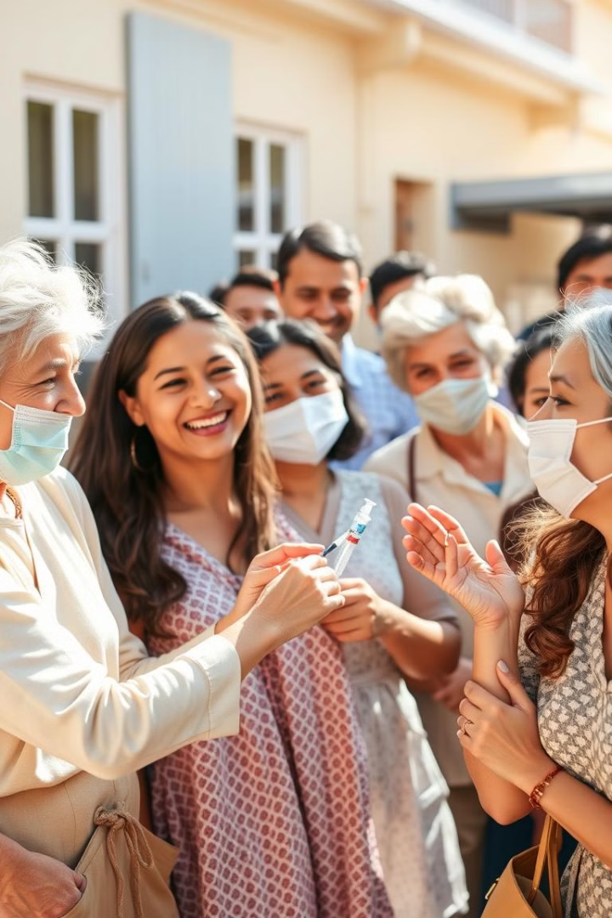
Public Health Vaccination Tracker: The Immunization Crusader
Welcome to the Immunization Crusader, a powerful tool for tracking vaccination progress. With this database, we can effectively protect communities and improve health outcomes.
PI
by Paul Imoukhedeme

Slide 2
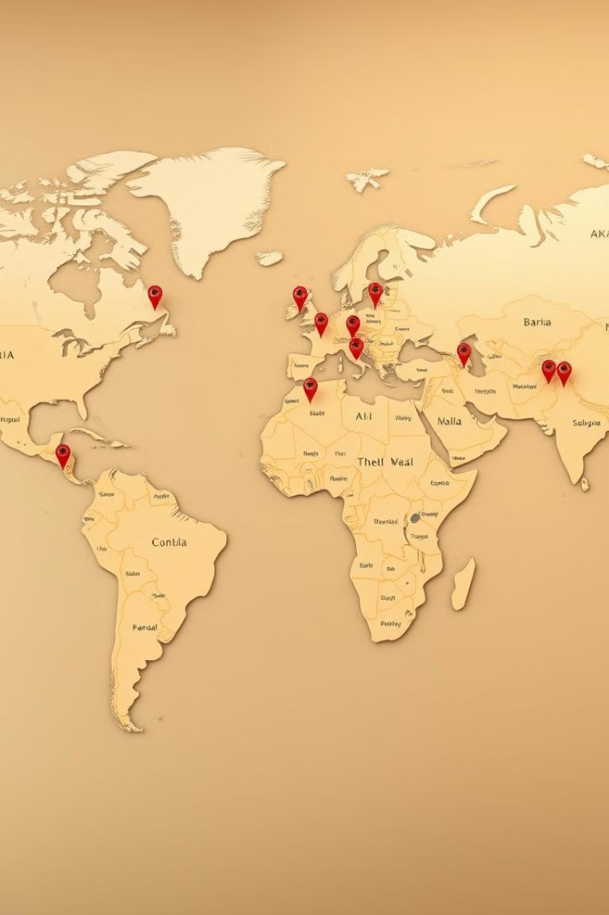
Track Your Vaccination Journey
1
Individual Profiles
2
Vaccination History
Create detailed profiles for each individual, capturing their vaccination journey.
Record the type of vaccine received, date of administration, and vaccination status.
3
Detailed Information
Track vital information, including birthdate, location, and contact details.

Slide 3

Vaccination Types: Your Arsenal of Shields
Vaccine Type
Disease Prevented
MMR
Measles, Mumps, Rubella
DTaP
Diphtheria, Tetanus, Pertussis
Hepatitis B
Hepatitis B virus infection
Hib
Haemophilus influenzae type b infection
Polio
Poliomyelitis

Slide 4
Vaccination Status: Ready for Battle
Completed
Pending
Overdue
Individuals have received all necessary doses of vaccines.
Individuals are awaiting their next vaccine dose.
Individuals have missed their scheduled vaccine doses.

Slide 5
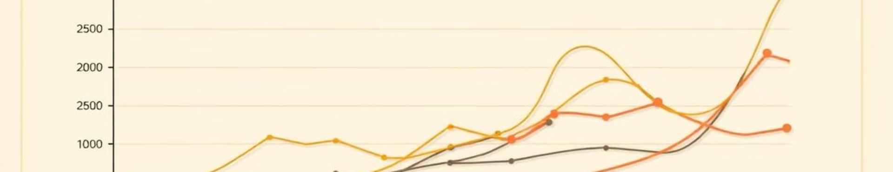



Visualize Vaccination Progress
Vaccination Rates
Geographic Distribution
Population Demographics
Track vaccination progress over time.
Visualize vaccination coverage across regions.
Analyze vaccination patterns by age, gender, and other factors.

Slide 6
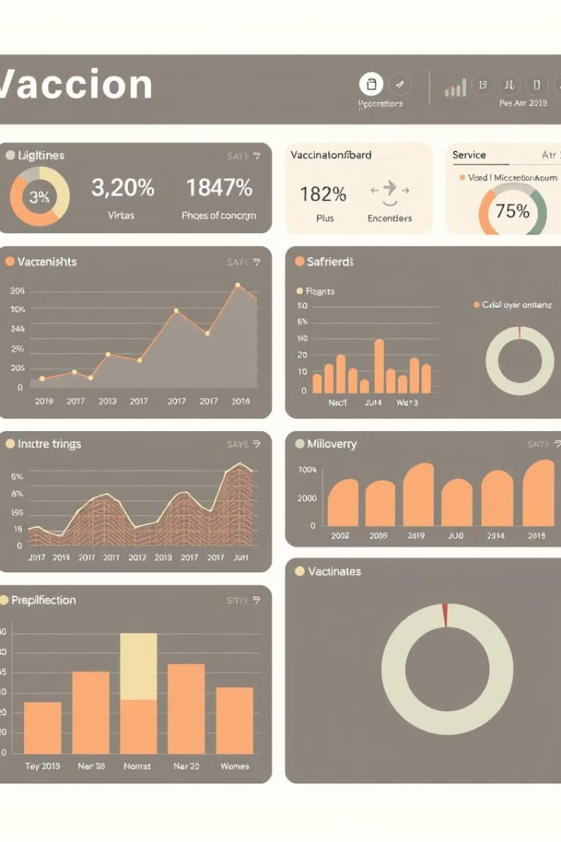
Generate Reports and Insights
Vaccination Coverage
Vaccine Effectiveness
Generate reports on overall vaccination coverage rates.
Analyze the effectiveness of different vaccine types.
Outbreak Trends
Identify potential outbreaks and monitor disease spread.

Slide 7




Data Security and Privacy
Confidentiality
Protect sensitive patient information.
Data Encryption
Secure data with advanced encryption methods.
Access Control
Limit access to authorized personnel.

Slide 8

Empower Your Community: The Immunization Crusader
This database is more than just a tracker. It's a tool to empower your community and protect those most vulnerable. Join the fight and become an Immunization Crusader today.

